Slide 1

Exceptions and String Handlin
SAMAR MANSOUR

Slide 2
Exception-Handling Fundamentals
Exception: an abnormal condition that arises in a code sequence at run time/ run time error
– Java exception is an object that describes an exceptional (that is, error) condition
– When an exceptional condition arises, an object representing that exception is created and thrown in the method that caused the error
• Exception can be
– Generated by the Java run-time system (relate to fundamental errors that violate the rules of the Java language)
– Manually generated (typically used to report some error condition to the caller of a method)

Slide 3
Keywords for exception handling
try block :
contains program statements that are to be to monitored for exceptions
– If an exception occurs within the try block, it is thrown
catch block:
Contain statements that catch this exception and handle it in some rational manner
– System-generated exceptions are automatically thrown by the Java runtime system.
Throw
Is used to manually throw an exception throws clause is used to specify any exception that is thrown out of a method.
finally block contains code that absolutely must be executed after a try block completes.

Slide 4
General form of an exception-handling block
try {
// block of code to monitor for errors
}
catch (ExceptionType1 exOb) {
// exception handler for ExceptionType1
}
catch (ExceptionType2 exOb) {
// exception handler for ExceptionType2
}
// ...
finally {
// block of code to be executed after try block ends
}

Slide 5
Exception Types
All exception types are subclasses of the built-in class Throwable
Below Throwable are two subclasses that partition exceptions into two branches:
Exception class: used for exceptional conditions that user programs should catch
RuntimeException etc are subclasses of Exception
2. Error class: used by the Java runtime system to indicate errors having to do with the run-time environment (eg Stack overflow)

Slide 6
Exception Types Diagram
Throwable
Exception
Error
RuntimeException

Slide 7
Uncaught Exception
Uncaught exception: caught by the default handler (provided by the Java run-time system) that:
– displays a string describing the exception
– prints a stack trace from the point at which the exception occurred
– terminates the program
Example:
java.lang.ArithmeticException: / by zero at Exc0.main(Exc0.java:4)

Slide 8
Using try and catch
Exception handling benefits
– allows you to fix the error
– prevents the program from automatically terminating
class Exc2 {
public static void main(String args[]) {
int d, a;
try { // monitor a block of code.
d = 0;
a = 42 / d;
System.out.println("This will not be printed.");
}
catch (ArithmeticException e) {
// catch divide-by-zero error
System.out.println("Division by zero.");
}
System.out.println("After catch statement.");
}
}

Slide 9
Another Example
// Handle an exception and move on.
import java.util.Random;
class HandleError {
public static void main(String args[]) {
int a=0, b=0, c=0;
Random r = new Random();
for(int i=0; i<32000; i++) {
try {
b = r.nextInt();
c = r.nextInt();
a = 12345 / (b/c);
}
catch (ArithmeticException e) {
System.out.println("Division by zero.");
a = 0; // set a to zero and continue
}
System.out.println("a: " + a);
}
}
}

Slide 10
Displaying a Description of an Exception
Throwable overrides the toString( ) method (defined by Object) so that it returns a string containing a description of the exception
catch (ArithmeticException e) {
System.out.println("Exception: " + e);
a = 0; // set a to zero and continue
}
OUTPUT Exception: java.lang.ArithmeticException: / by zero

Slide 11
Multiple catch Clauses
Use when more than one exception could be raised by a single piece of code.
When an exception is thrown, each catch statement is inspected in order, and the first one whose type matches that of the exception is executed
– All others are bypassed
– execution continues after the try / catch block
NOTE:
exception subclasses must come before any of their superclasses because a catch statement that uses a superclass will catch exceptions of that type plus any of its subclasses

Slide 12
Multiple catch Clauses (Example)
try {
int a = args.length;
System.out.println("a = " + a);
int b = 42 / a;
int c[] = { 1 };
c[42] = 99;
}
catch(ArithmeticException e) {
System.out.println("Divide by 0: " + e);
}
catch(ArrayIndexOutOfBoundsException e) {
System.out.println("Array index oob: " + e);
}
System.out.println("After try/catch blocks.");

Slide 13
Nested try Statements
A try statement can be inside the block of another try.
Each time a try statement is entered, the context of that exception is pushed on the stack
If an inner try statement does not have a catch handler for a particular exception, the stack is unwound and the next try statement’s catch handlers are inspected for a match
This continues until one of the catch statements succeeds, or until all of the nested try statements are exhausted.
If no catch statement matches, then the Java run-time system will handle the exception

Slide 14
Nested try Statements (Example
try {
int a = args.length;
int b = 42 / a;
System.out.println("a = " + a);
try { // nested try block
if(a==1) a = a/(a-a); // one command-line arg, division by zero
if(a==2) {
int c[] = { 1 };
c[42] = 99; // two command-line args, out-of-bounds exception
}
}
catch(ArrayIndexOutOfBoundsException e) {
System.out.println("Array index out-of-bounds: " + e);
}
catch(ArithmeticException e) {
System.out.println("Divide by 0: " + e);
}

Slide 15
throw
To throw an exception explicitly, use the throw statement:
Flow of execution stops immediately after the throw statement.
Nearest enclosing try block is inspected to see if it has a catch statement that matches the type of exception and control is transferred to that statement.
No match: next enclosing try statement is inspected, and so on
No matching catch found in any block: default exception handler halts the program and prints the stack trace

Slide 16
throw (example)
class ThrowDemo {
static void demoproc() {
try {
throw new NullPointerException("demo");
}
catch(NullPointerException e) {
System.out.println("Caught inside demoproc.");
throw e; // rethrow the exception
}
}
public static void main(String args[]) {
try {
demoproc();
}
catch(NullPointerException e) {
System.out.println("Recaught: " + e);
}
}
}

Slide 17
throws
If method can cause an exception that it does not handle
Then method’s declaration must include a throws clause (that lists the types of exceptions that a method might throw)
Necessary for all exceptions, except Error or RuntimeException, or any of their subclasses

Slide 18
throws (example)
class ThrowsDemo {
static void throwOne() throws IllegalAccessException
{
System.out.println("Inside throwOne.");
throw new IllegalAccessException("demo");
}
public static void main(String args[]) {
try {
throwOne();
}
catch (IllegalAccessException e) {
System.out.println("Caught " + e);
}

Slide 19
finally
finally creates a block of code that will be executed after a try /catch block has completed and before the code following the try/catch block:
finally block will execute whether or not an exception is thrown.
If an exception is thrown, the finally block will execute even if no catch statement matches the exception.
Useful for closing file handles and freeing up any other resources
finally clause is optional.

Slide 20
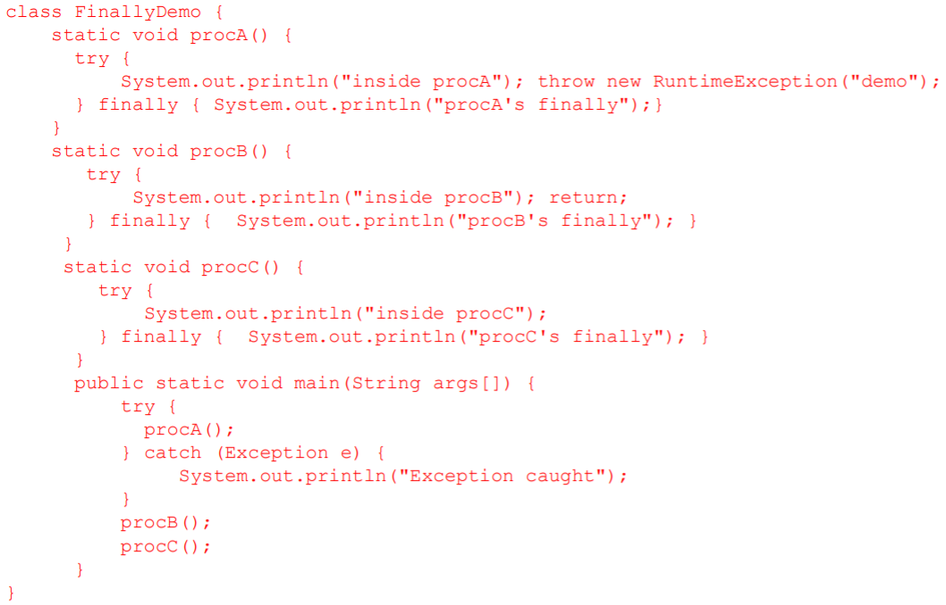
finally (example)

Slide 21
Throw & Throws
Both keywords are used in exception handling(which handle run time errors)
The keywords itself described about differences.

Slide 22
Throw | Throws
This is a keywords used to hit the exception in the block of the program Throw hits a single exception at the run time but IT can throw any exception type like arithmetic exception,numeric exception,sql exception etc Write respective catch blocks for all type of exception. It should be lies inside the block(function) inside the try block(which check the exception) Example: public void print() { //throw statement (which throw single exception and catch block handles exception } | Throws is also keyword which lies outside the block Which handle one or more exceptions But we should mention the type of exception in adjacent to throws keyword Example: Let us take void main function public static void main(string san[]) throws Ioexception,sqlexception { }

Slide 23
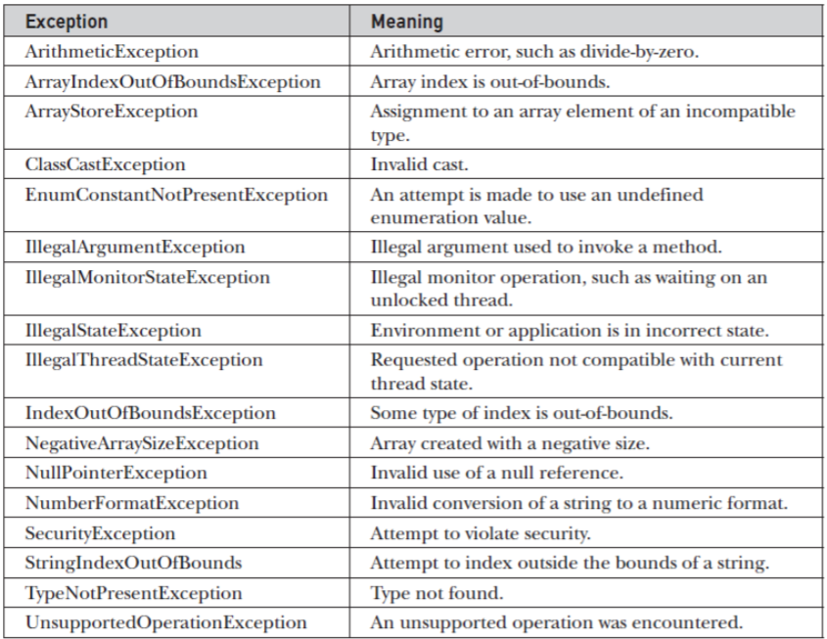
Java’s Built-in Exceptions
Java’s Unchecked RuntimeException Subclasses Defined in java.lang

Slide 24
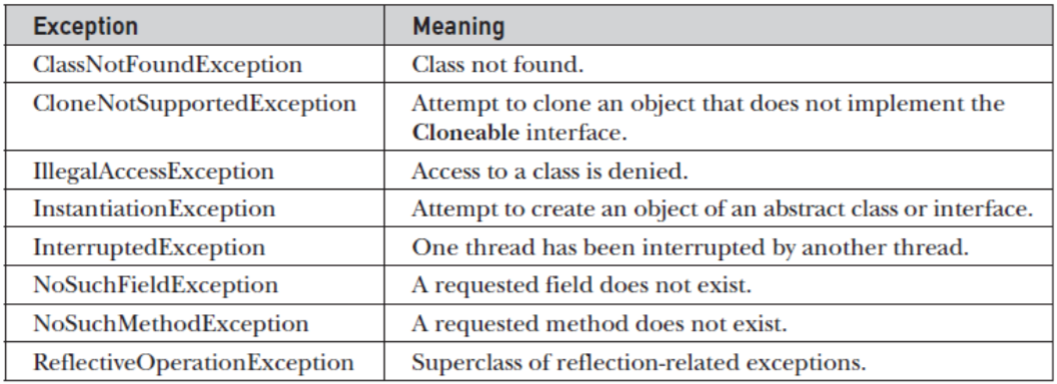
Java’s Built-in Exceptions
Java’s Checked Exceptions Defined in java.lang

Slide 25
Creating our Own Exception
In java we can create our own exception class and throw that exception using throw keyword. These exceptions are known as user-defined or custom exceptions.
To create our own exception :
first we have to create a class for exception which is extends from Exception class.
Then create another class having main method.
Now throw the new created exception class in the try block
Notes:
User-defined exception must extend Exception class.
The exception is thrown using throw keyword.

Slide 26
Creating our Own Exception (Example)
// program to demonstrate creating our own exception
class MyException extends Exception
{
int a;
MyException(int b)
{
a=b;
}
public String toString()
{
return ("Exception Number = "+a) ;
}
}
class JavaException {
public static void main(String args[]) {
try {
throw new MyException(2);
// throw is used to create a new exception and throw it.
}
catch(MyException e){
System.out.println(e) ;
}
}
}
Output:
Exception Number = 2

Slide 27
Finally and Close()
close() statement is used to close all the open streams in a program. Its a good practice to use close() inside finally block.
Since finally block executes even if exception occurs so you can be sure that all input and output streams are closed properly regardless of whether the exception occurs or not.

Slide 28
I/O Streams
A stream is a communication channel that a program has with the outside world. It is used to transfer data items in succession.
An Input/Output (I/O) Stream represents an input source or an output destination. A stream can represent many different kinds of sources and destinations, including disk files, devices, other programs, and memory arrays.
Streams support many different kinds of data, including simple bytes, primitive data types, localized characters, and objects. Some streams simply pass on data; others manipulate and transform the data in useful ways.
No matter how they work internally, all streams present the same simple model to programs that use them: A stream is a sequence of data.

Slide 29
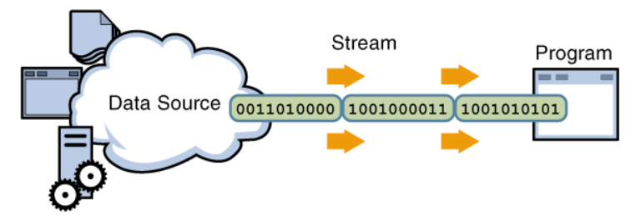
Reading information into a program.
A program uses an input stream to read data from a source, one item at a time:

Slide 30
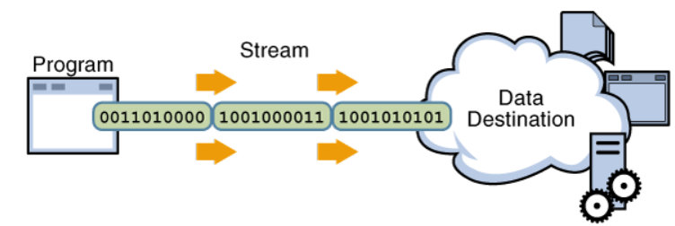
Writing information from a program.
A program uses an output stream to write data to a destination, one item at time:
The data source and data destination pictured above can be anything that holds, generates, or consumes data. Obviously this includes disk files, but a source or destination can also another program, a peripheral device, a network socket, or an array.

Slide 31
The Java IO API
The java.io package contains many classes that your programs can use to read and write data.
Most of the classes implement sequential access streams. The sequential access streams can be divided into two groups:
Those that read and write bytes.
Those that read and write Unicode characters
Each sequential access stream has a specialty, such as:
Reading from or writing to a file
Filtering data as its read or written
Serializing an object.

Slide 32
Types of Streams
Byte Streams:
Byte streams perform input and output of 8-bit bytes.
They read and write data one byte at a time.
Using byte streams is the lowest level of I/0, so if you are reading or writing character data the best approach is to use character streams.
Character Streams:
All character stream classes are descended from Reader and Writer.
We are going to use the Reader and Writer classes that perform file I/0, FileReader and FileWriter.

Slide 33
Finally block without catch
A try-finally block is possible without catch block. Which means a try block can be used with finally without having a catch block.
InputStream input = null;
try {
input = new FileInputStream("inputfile.txt");
}
finally {
if (input != null) {
try {
in.close();
}
catch (IOException exp) {
System.out.println(exp);
}

Slide 34
Finally block and System.exit()
System.exit() statement behaves differently than return statement. Unlike return statement whenever
System.exit() gets called in try block then Finally block doesn’t execute. Example:
https://sandeepdass003.wordpress.com/2016/06/11/try-catch-finally-with-system-exitint-and-return/

Slide 35
String Handling

Slide 36
Strings
Strings are reference types but we don’t need to use the new operator to allocate memory to them. We can declare string variables like the primitives since we use them a lot.
String message = “Hello World”;

Slide 37
Useful String Methods
This is some useful methods:
We can concatenate or join strings by using the: + operator. Because string is a class, it has members we can access using the dot operator. text.
endsWith() Method: returns true/false we can check what characters end in the text.
startsWith() Method: returns true/false we can check what characters start in the text.
length() Method: we use it to get a length of the string, in other words the number of the characters.
indexOf() Method: returns the first character or sentences of the string. If we pass a character that doesn’t exists in the string, we’ll get -1.

Slide 38
Useful String Methods
replace() Method: this method gets two arguments: the first one is the target (old char), the second one is the replacement(new char).
toLowerCase() Method: it returns a string in lower case. But does not change the original string.
toUpperCase() Method: it returns a string in upper case. But does not change the original string.
trim() Method: it ripped off the extra white spaces at the begging or at the end of the string.
Note:
the replace method dose not modify our original string. It returns a new string. In java strings are immutable, we cannot change them. So, keep in your minds any method that modify string will always returns a new string object.

Slide 39
String
// Most common, short way
String str1 = "Hello World";
// Using the `new` keyword and passing text to the constructor
String str2 = new String("Hello World");
// Initializing an array of characters and assigning them to a String
char[] charArray = {'H', 'e', 'l', 'l', 'o', ' ', 'W', 'o', 'r', 'l', 'd'};
String str3 = new String(charArray);

Slide 40
Comparing Strings
Relational operators such as < and == fail on objects.
Scanner console = new Scanner(System.in);
System.out.print("What is your name? ");
String name = console.next();
if (name == "Lance") {
System.out.println("Pain is temporary.");
System.out.println("Quitting lasts forever.");
}
This code will compile, but it will not print the quote.
== compares objects by references (seen later), so it often gives false even when two Strings have the same letters.

Slide 41
The equals method
Objects are compared using a method named equals.
Scanner console = new Scanner(System.in);
System.out.print("What is your name? ");
String name = console.next();
if (name.equals("Lance")) {
System.out.println("Pain is temporary.");
System.out.println("Quitting lasts forever.");
}
Technically this is a method that returns a value of type boolean,
the type used in logical tests.

Slide 42
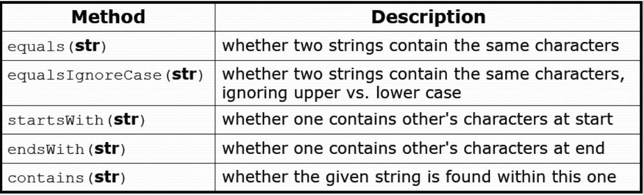
String test methods
String name = console.next();
if(name.endsWith("Kweli")) {
System.out.println("Pay attention, you gotta listen to hear.");
} else if(name.equalsIgnoreCase("NaS")) {
System.out.println("I never sleep 'cause sleep is the cousin of
death.");
}

Slide 43
Comparing char values
You can compare char values with relational operators:
'a' < 'b' and 'X' == 'X' and 'Q' != 'q’
An example that prints the alphabet:
for (char c = 'a'; c <= 'z'; c++) {
System.out.print(c);
}
You can test the value of a string's character:
String word = console.next();
if (word.charAt(word.length() - 1) == 's') {
System.out.println(word + " is plural.");
}

Slide 44
Formatting text with Printf
System.out.printf("format string", parameters);
A format string can contain placeholders to insert parameters:
%d integer
%f real number
%s string
these placeholders are used instead of + concatenation
Example:
int x = 3;
int y = -17;
System.out.printf("x is %d and y is %d!\n", x, y);
// x is 3 and y is -17!
printf does not drop to the next line unless you write \n

Slide 45
printf width
%Wd integer, W characters wide, right-aligned
%-Wd integer, W characters wide, left-aligned
%Wf real number, W characters wide, right-aligned
for (int i = 1; i <= 3; i++) {
for (int j = 1; j <= 10; j++) {
System.out.printf("%4d", (i * j));
}
System.out.println(); // to end the line
}
Output:
1 2 3 4 5 6 7 8 9 10
2 4 6 8 10 12 14 16 18 20
3 6 9 12 15 18 21 24 27 30

Slide 46
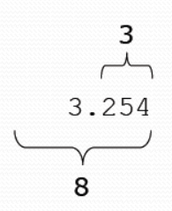
printf precision
%.Df real number, rounded to D digits after decimal
%W.Df real number, W chars wide, D digits after decimal
%-W.Df real number, W wide (left-align), D after decimal
double gpa = 3.253764;
System.out.printf("your GPA is %.1f\n", gpa);
System.out.printf("more precisely: %8.3f\n", gpa);
Output:
your GPA is 3.3
more precisely:

Slide 47
printf question
Modify our Receipt program to better format its output.
Display results in the format below, with 2 digits after .
Example log of execution:
How many people ate? 4
Person #1: How much did your dinner cost? 20.00
Person #2: How much did your dinner cost? 15
Person #3: How much did your dinner cost? 25.0
Person #4: How much did your dinner cost? 10.00
Subtotal: $70.00
Tax: $5.60
Tip: $10.50
Total: $86.10

Slide 48
printf answer
// Calculates total owed, assuming 8% tax and 15% tip
public static void results(double subtotal) {
double tax = subtotal * .08;
double tip = subtotal * .15;
double total = subtotal + tax + tip;
// System.out.println("Subtotal: $" + subtotal);
// System.out.println("Tax: $" + tax);
// System.out.println("Tip: $" + tip);
// System.out.println("Total: $" + total);
System.out.printf("Subtotal: $%.2f\n", subtotal);
System.out.printf("Tax: $%.2f\n", tax);
System.out.printf("Tip: $%.2f\n", tip);
System.out.printf("Total: $%.2f\n", total);
}
}

Slide 49
StringBuffer and StringBuilder
StringBuffer and StringBuilder objects basically hold the same value as a String object - a sequence of characters.
Both StringBuffer and StringBuilder are also mutable which means that once we assign a value to them, that value is processed as an attribute of a StringBuffer or StringBuilder object.

Slide 50
StringBuilder vs StringBuffer
These two classes are almost identical to one another - they use methods with the same names which return the same results.
Although there are two major differences between them:
Thread Safety.
Speed.

Slide 51
Thread Safety
StringBuffer methods are synchronized, which means that only one thread can call the methods of a StringBuffer instance at a time.
On the other hand StringBuilder methods are not synchronized, therefore multiple threads can call the methods in StringBuilder class without being blocked.
So we have come to a conclusion that StringBuffer is a thread-safe class while StringBuffer isn't.
Is that something you should worry about? Maybe. If you are working on application which uses multiple threads it can be potentially dangerous to work with StringBuilder.

Slide 52
Speed
StringBuffer is actually two to three times slower than StringBuilder. The reason behind this is StringBuffer synchronization - only allowing 1 thread to execute on an object at a time results in much slower code execution.

Slide 53
Methods
Both StringBuffer and StringBuilder have the same methods (besides synchronized method declaration in the StringBuilder class). Let's go through some of the most common ones:
append()
insert()
replace()
delete()
reverse()

Slide 54
Example
StringBuffer sb1 = new StringBuffer("Buffer no 1");
System.out.println(sb1);
sb1.append(" - and this is appended!");
System.out.println(sb1);
sb1.insert(11, ", this is inserted");
System.out.println(sb1);
sb1.replace(7, 9, "Number");
System.out.println(sb1);
sb1.delete(7, 14);
System.out.println(sb1);
sb1.reverse();
System.out.println(sb1);

Slide 55
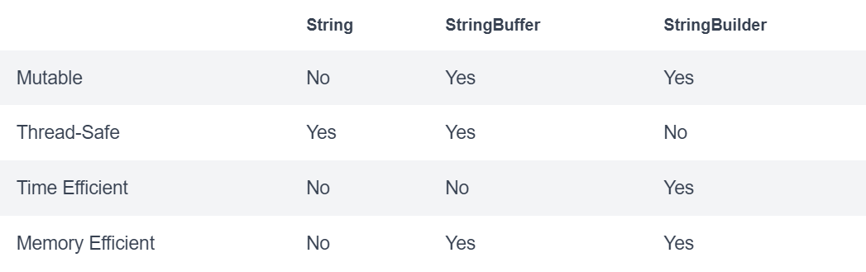
String vs StringBuilder vs StringBuffer

Slide 56
Note
As we can see from the table above, String is both less efficient in time and memory, but that doesn't mean we should never use it again.
In fact, String can be very handy to use because it can be written fast and if you ever develop an application which stores Strings that are not going to be manipulated/changed later, it's absolutely fine to use String.

Slide 57
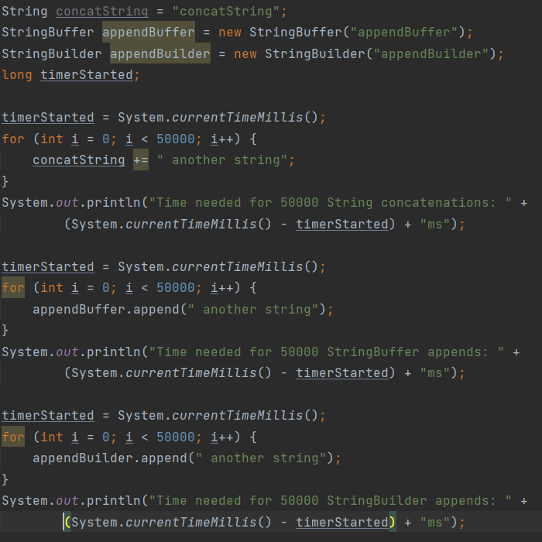
Example In order to show how much efficient String, StringBuffer, and StringBuilder are we are going to perform a benchmark test:

